Slide 1
Architectural Design

Slide 2
Design? Why?
lA transition from requirements to code
lA blue-print of solution to the problem
lHelps resolve issues:
-Complexity
-Quality / Maintainability
-Re-usability, Efficiency, etc.
Notes:
Design Levels:
1. Architectural Level (abstraction high)
2. Interface Design
3. Component Design
4. Data Structures/Algorithms (abstraction low)

Slide 3
Design Steps
Architectural Design
Concerned with components and how they interact
Component Design
Implementation units (classes, functions etc)
Relationships
Interface Design
Interaction with the outer world
Data exchange formats
Data Design
Data Structures (to contain information)
Notes:
Architectural Design
An early stage of the system design process.
Represents the link between specification and design processes.
Often carried out in parallel with some specification activities.
It involves identifying major system components and their communications.

Slide 4
Decomposition and Views
Some design problems have no design solutions
Some popular design methods
Functional decomposition
Feature-oriented decomposition
Data Oriented decomposition
Event Oriented decomposition
Object Oriented decomposition

Slide 5
Functional Decomposition
partitions functions or requirements into modules
begins with the functions that are listed in the requirements specification
lower-level designs divide these functions into subfunctions, which are then assigned to smaller modules
describes which modules (sub-functions) call each other

Slide 6
Feature Oriented Decomposition
Assigns features to modules
High level design describes the system in terms of a service and a collection of features
Lower level design describes how each feature augments the service and identifies interactions among the features.

Slide 7
Data Oriented decomposition
Focuses on how data will be partitioned into modules
High level design describes conceptual data structures
Lower level design provide details as to how
Data are distributed among modules
Distributred data realize the conceptual models

Slide 8
Process Oriented decomposition
Partitions the system into concurrent processes
High level design
Identifies the main tasks of the system
Assigns tasks to runtime processes
Determines how all the tasks are being coordinated with each other
Lower Level design describes these processes in more detail

Slide 9
Event Oriented decomposition
Focuses on the events that the system must handle and assigns responsibilities for events to different modules
High level design catalogues the system’s expected input events
Lower level designs decompose the system into states and describes how events trigger state transformations

Slide 10
Object Oriented decomposition
Assigns objects to modules
High level design identifies the system’s object types and explains how objects are related to one another
Lower level design details the object attributes and operations

Slide 11
Component Based Software Engineering
method of software development whereby systems are created by assembling together preexisting components
A component is “a self-contained piece of software with a well-defined set of interfaces” that can be developed, bought, and sold as a distinct entity
The goal of CBSE is to support the rapid development of new systems, by reducing development to component integration, and to ease the maintenance of such systems by reducing maintenance to component replacement
At this point, CBSE is still more of a goal than a reality with considerable on-going research

Slide 12
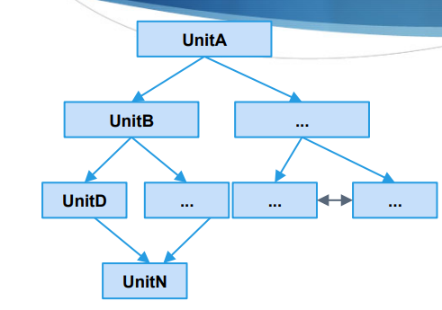
Design Strategies
Systems are typically designed as a hierarchy.
● UnitN provides a service used by UnitD.
● UnitD provides a service used by UnitB.
● UnitB provides a service used by UnitA.
Design strategies dictate how these units and their connections are laid out.

Slide 13
Centralized Design
System is designed from a functional viewpoint:
call and return model. Typical in C and non-OO languages.
Execution is controlled from a central point in the system.
A method is called, the result is passed back to the controlling location, then that is passed into the next method.
System is designed as a set of independent services that communicate only with a central master component.
The system state is centralized and shared between the functions operating on that state.
All data is stored by the master component. S Each called component receives all data it needs from the master.

Slide 14
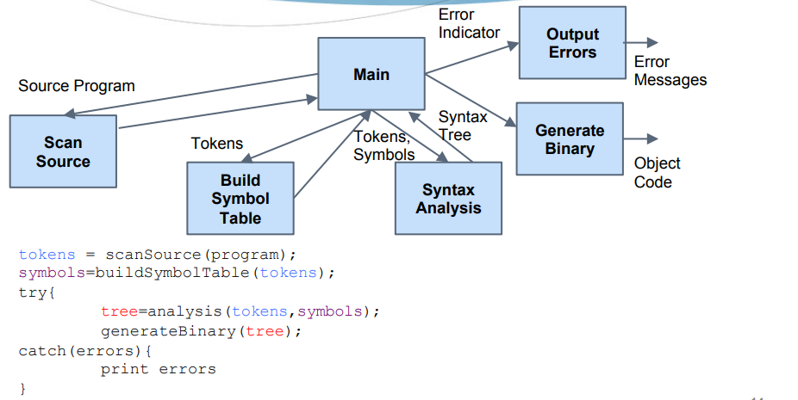
Example

Slide 15
Decentralized Design
Basis of object-oriented design S System is designed as a collection of interacting components.
System state is decentralized and each component manages its own data.
Multiple instances of a component may exist and communicate.
Most modern systems are are built on decentralized design
Easier to isolate errors in individual components.

Slide 16
Architectural Qualities architecture plays key role in implementing non-functional requirements
Performance
Minimize communication using fewer, larger components, stored on a local machine. Consider opportunities for parallel execution.
Security
Layer the architecture, with the critical components protected in innermost layers.
Availability
Include redundant components so that they can be replaced or updated without stopping operation.
Maintainability
Design system with large number of self-contained components that may readily be changed. Avoid shared data structures.
Notes:
These qualities often conflict. It is hard to achieve multiple qualities at once. S Using fewer subsystems improves performance, but hurts maintainability. S Introducing redundant data improves availability, but makes security more difficult.

Slide 17
Software Architectural Styles

Slide 18
Data Flow Style
Information flow from one component to another in a sequential fashion
A series of transformation before getting the output
The system has
Streams of data (pipe) for input and output
Transformation of the data (filter)
Examples
ETL in Dataware housing
Compilers.
Notes:
Variation is the Pipe and filter architecture

Slide 19
Data Flow Style
Advantages
Modularity and Reuse: Same filters can be reused to create different configurations
Enhancement: New filters may be added / replaced to create improvements
Performance: Parallel processing in Pipe and Filter case
Disadvantages
Do not handle interactive applications very well since output is obtained after a series of transformations
If each component is designed completely independent, then may need certain filters to simply transform the output of one component in order to make it compatible with the input of the next – extra processing that may lead to performance issues
May lead to tight data coupling if components aren't designed completely independent

Slide 20
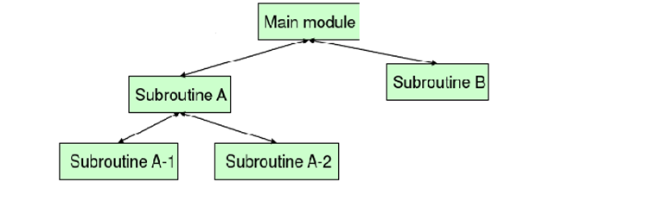
Call and Return Architecture
Manager and worker modules
All interaction is done at the manager level
Manager delegates tasks to workers
All work is done by workers.

Slide 21
Call and Return Architecture
Manager is responsible for all the control and data flow
Each worker may delegate responsibility but is required to do its own work irrespective of what’s the peers are doing
Due to modularization, identifying problem areas is easy
A non-performing worker can easily be replaced / fixed
At times tight data coupling among peer modules may exist if interfaces aren't well-defined – may result in ripples to other modules if internal data structures change

Slide 22

Layered Architecture
variation of the Call and Return
System is designed in a stack of layers
A layer hides lower layers in the stack
System functionality is organized into layers, with each layer dependent only on the layer immediately below it.
Allows layers to change independently.
Supports incremental development.
Notes:
Higher layer hides the lower layers

Slide 23
Layered Architecture
Advantages
Allows replacement of entire layers as long as interface of the layer does not change.
When changes occur, only the adjacent layer is affected.
Redundant features (authentication) in each layer can enhance security and dependability.
Disadvantages
Clean separation between layers is often hard to achieve.
Performance can be a problem because of multiple layers of processing between call and return.

Slide 24
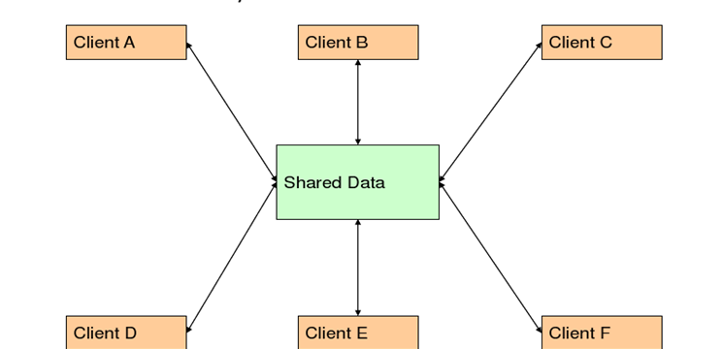
Data Centered Architecture
Shared data is held in a central repository and may be accessed by all subsystems
Multiple clients sharing a single data repository
Repository can either be passive (traditional database) or active (blackboard)
Whatever written on the blackboard is visible to other components – facilitates communication among components
Notes:
Also known as repository architecture

Slide 25
Data Centered Architecture
Advantages
Efficient way to share large amounts of data.
Components can be independent. So they can be easily added/modified/ removed without affecting other components.
May be more secure.
All data can be managed consistently (centralized backup, security, etc)
Disadvantages
Single point of failure.
Subsystems must agree on a data model (inevitably a compromise).
Data evolution is difficult and expensive.
Communication may be inefficient.

Slide 26
Client Server Architecture
Two types of components:
Server components offer services
Clients access them using a request/reply protocol
Client may send the server an executable function, called a callback
The server subsequently calls under specific circumstances

Slide 27
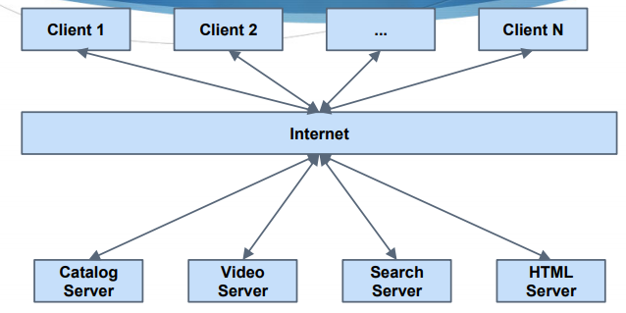
Example:

Slide 28
Client Server Architecture
Advantages
Distributed architecture. Failure in one server does not impact others.
Makes effective use of networked systems and their CPUs.
Easy to add new servers or upgrade existing servers.
Disadvantages
Performance is unpredictable (depends on system and network).
Each service is a point of failure.
Management problems if servers owned by others.

Slide 29
Classroom Activity
Discuss and draw architectures of the following systems. Justify your selection of the architectural pattern you choose.
An automated ticket issuing system used by passengers at a railway station.
A computer controlled video conferencing system that allows video, audio and computer data to be visible to several participants at the same time.

Slide 30
Achieving Quality Attributes
Architectural styles provide general beneficial properties. Quality attributes also need to be supported:
Performance
Security
Reliability
Robustness
Usability

Slide 31
Achieving Quality Attributes Performance
Performance attributes describe constraints on system speed and capacity:
Response time: How fast does our software respond to requests?
Throughput: How many requests can it process per minute?
Load: How many users can it support before response time and throughput start to suffer?

Slide 32
Achieving Quality Attributes Performance
Tactics for improving performance include:
Improve utilization of resources
Manage resource allocation more effectively
First-come/first-served:
Explicit priority:
Earliest deadline first:

Slide 33
Achieving Quality Attributes Security
Two key architectural characteristics particularly relevant to security: immunity and resilience
Immunity: ability to thwart an attempted attack
Resilience: ability to recover quickly and easily from an attack
Notes:
The architecture encourages immunity by: Ensuring all security features are included in the design
Minimizing exploitable security weaknesses
The architecture encourages resilience by: Segmenting functionality to contain attack
Enabling the system to quickly restore functionality

Slide 34
Achieving Quality Attributes Reliability
A software system is reliable if it correctly performs its required functions under assumed conditions
Is the software internally free of errors?
A fault is the result of human error, compared to a failure, which is an observable departure from required behavior
Software is made more reliable by preventing or tolerating faults

Slide 35
Achieving Quality Attributes Reliability (continued)
Passive fault detection: wait until fault occurs during execution
Active fault detection: periodically check for symptoms or try to anticipate when failures will occur
Exceptions: situations that cause the system to deviate from its desired behavior
Include exception handling in design to handle exception and return system to acceptable state
Typical exceptions include:
Failing to provide a service
Providing the wrong service
Corrupting data
Violating a system invariant (e.g.; security property)
Deadlocking

Slide 36
Achieving Quality Attributes Reliability (continued)
Fault recovery: handling fault immediately to limit damage
Fault recovery tactics:
Undoing transactions: manage a series of actions as a single transaction that are easily undone if a fault occurs midway through the transaction
Checkpoint/rollback: software records a checkpoint of current state; rolls back to that point if system gets in trouble
Backup: system automatically substitutes faulty unit with backup
Degraded service: returns to previous state, offers degraded version of the service
Notes:
Correct and continue: detects the problem and treats the symptoms
Report: system returns to its previous state and reports the problem to an exception-handling unit

Slide 37
Achieving Quality Attributes Usability
Usability reflects the ease in which a user is able to operate the system
User interface should reside in its own software unit
Some user-initiated commands require architectural support
There are some system-initiated activities for which the system should maintain a model of its environment

Slide 38
Achieving Quality Attributes Business Goals
Business Goals are quality attributes the system is expected to exhibit (e.g., minimizing the cost of development and time to market)
Buy vs. Build
Save development time, money
More reliable
Existing components create constraints; vulnerable to supplier
Initial development vs. maintenance costs
Save money by making system modifiable
Increased complexity may delay release; lose market to competitors
Notes:
New vs. known technologies
Acquiring expertise costs money, delays product release
Either learn how to use the new technology or hire new personnel
Eventually, we must develop the expertise ourselves

Slide 39
Architecture Evaluation and Refinement
Design is iterative: we propose design decisions, assess, make adjustments, and propose more decisions
Many techniques to evaluate the design:
Trade-off analysis
Cost-benefit analysis
Prototyping

Slide 40
Architecture Evaluation and Refinement Trade-off Analysis
Often several alternative designs to consider
professional duty to explore design alternatives and not simply implement the first design that comes to mind
different members of design team may promote competing designs
need a measurement-based method for comparing design alternatives

Slide 41

Architecture Evaluation and Refinement One Specification, Many Designs
One specification, many designs: to see how different designs can be used to solve the same problem

Slide 42
Architecture Evaluation and Refinement One Specification, Many Designs
One specification, many designs: to see how different designs can be used to solve the same problem
two different architectural designs to implement KWIC (Key Word in Context problem)
shared data
pipe and filter

Slide 43
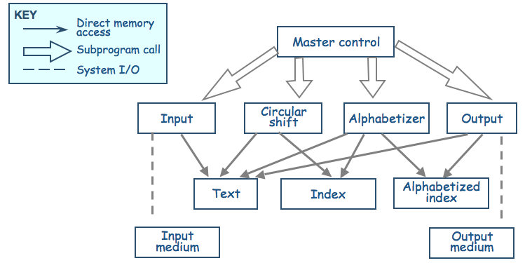
Architecture Evaluation and Refinement One Specification, Many Designs (continued)
Shared data solution
Four functional parts: input, circular shift, alphabetize, and output

Slide 44
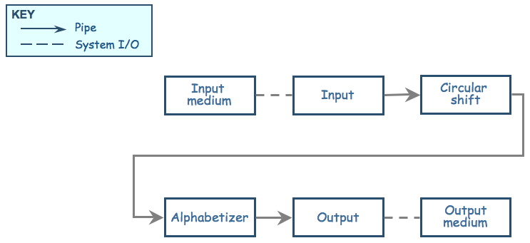
Architecture Evaluation and Refinement One Specification, Many Designs (continued)
Pipe-and-filter solution: The sequence of processing is controlled by the sequence of filters

Slide 45
Architecture Evaluation and Refinement One Specification, Many Designs (continued)
Comparison of KWIC solutions on the basis of important attributes
Attribute | Shared Data | Pipe and Filter
Easy to change Algorithm | - | +
Easy to Change Data | - | -
Easy to Add Functionality | + | +
Performance | - | +
Efficient Data Rep | + | -
Easy to Reuse | - | +
+ means that the design has the attribute
- means that the attribute is not an aspect of the design

Slide 46
Architecture Evaluation and Refinement One Specification, Many Designs (continued)
Weighted comparison of KWIC solutions
Attribute | Priority | Shared data | Pipe and filter
Easy to change algorithm | 1 | 1 | 5
Easy to change data representation | 4 | 1 | 1
Easy to change function | 3 | 4 | 5
Good performance | 3 | 5 | 2
Easy to reuse | 5 | 1 | 5
Highest Priority of an attribute = 5, Lowest priority = 1. For example, Reusability is the most desirable attribute here
For example score for pipe and filter = 1x5 + 4x1 + 3x5 + 3x2 + 5x5 = 55.
Score for shared data: 1x1 + 4x1 + 3x4 + 3x5 + 5x1 = 37
Pick the design with the highest score

Slide 47
Architecture Evaluation and Refinement One Specification, Many Designs (continued)
Other attributes to consider
Modularity
Testability
Security
Ease of understanding
Ease of integration

Slide 48
Group homework: Due 28th October (in class)
Create architecture diagrams of your system from three of the perspectives discussed in class.
Discuss the pros and cons of each of the three architectural patterns you chose above.
The pros and cons must be discussed from the perspective of your project.
Also discuss how the architectural patterns you chose for your project affect the nonfunctional requirements.
Finally using Architecture evaluation technique, determine the best architecture style for your project.

